Slide 1
Forecasting cryptocurrency price Trends using ARIMA and LSTM
Harideep Aepuri
3047113

Slide 2

Introduction
Cryptocurrency prices will fluctuate based on market demand.
The project focus on predicting bitcoin prices.
I used two different approach's ARIMA a statistical model which is used to capture trends and another one is LSTM deep learning model to learn complex patterns

Slide 3
Problem Statement
Bitcoin prices are highly volatile and prices can change rapidly over the time which makes the price prediction challenging
The traditional methods are struggle to capture the sudden changes.
There is a need to evaluate the models which can handle both trend and fluctuations
In this Project I will compare both models to identify the better performing model for prediction
Bitcoin Prices
Highly volatile
Prediction challenging
Traditional methods
Best Model

Slide 4
Data Collection and Cleaning
The Bitcoin Data was collected from Binance API
The collected was in BTCUSD which has interval of 1-minute and duration of 60 days around 80000 records
The dataset has features like open, High, Low, Close , volume, open time, close time, Quote asset volume, Number of trades"
UNIX timestamp conversation of data to date and time format
Converted the variables like OHLC and volume to numeric format and removed the unnecessary columns
Checked for duplicate and missing values in data and prepared data for both ARIMA and LSTM models

Slide 5
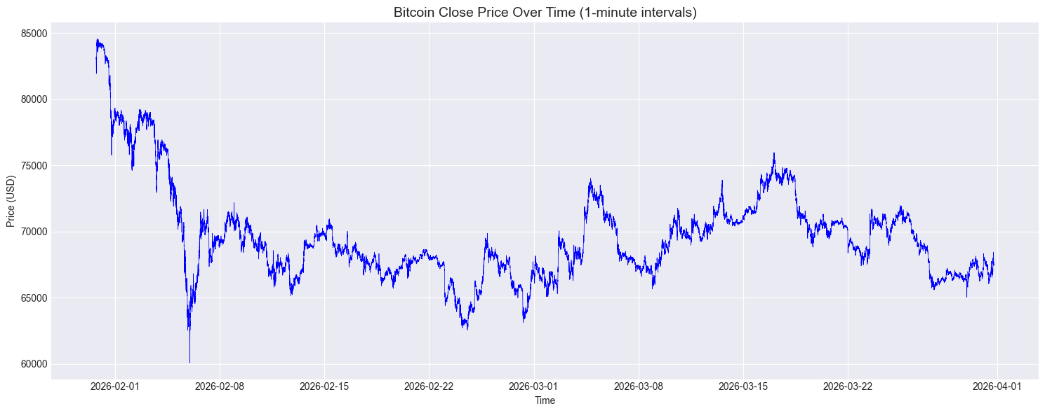
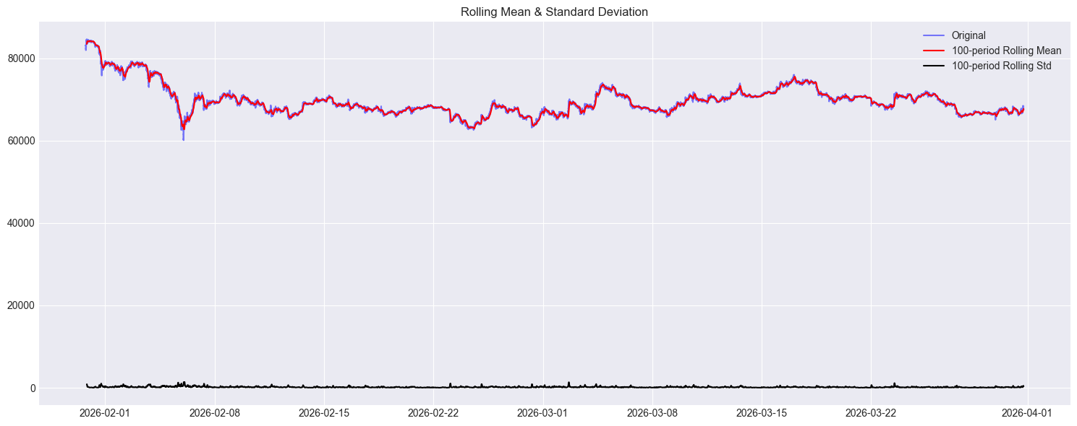
Exploratory Data Analysis-Trend and Stationarity Insights
In the Graph the bitcoin close prices are fluctuating rapidly
There is no constant mean the values are shifting across ranges
From the rolling mean and standard deviation graph both mean and standard deviation are changing continuously
Which indicates the data is non-stationary

Slide 6
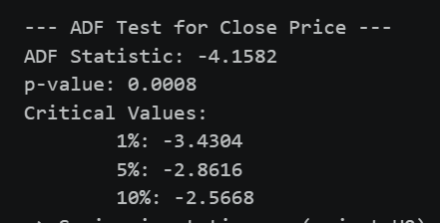
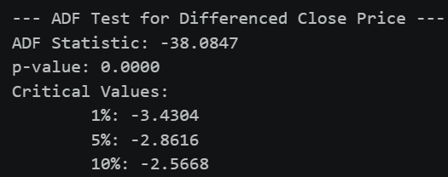
Stationarity Test
Initially the EDA shows bitcoin data is not stationary due to price fluctuations.
To test the data is stationary or not , applied Augmented Dickey-Fuller (ADF) test
The original close price series showed a p-value of 0.0008, which is less than 0.05, indicating that the data is stationary.
Further after Appling the differencing resulting in lower p-value 0.00 confirms the data is strong stationary suitable for time series modelling.

Slide 7
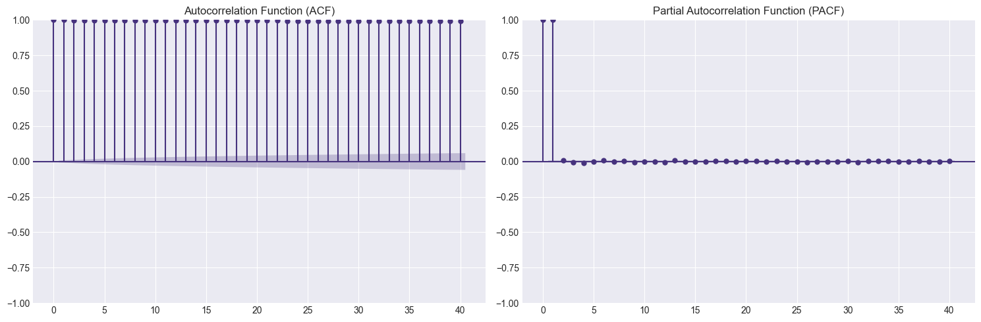
ACF & PACF Analysis for ARIMA parameter Selection
The ACF plot shows Some strong correlation across many lags
Which indicates the past values highly influence on current values
From this graph is shows there is no sharp cut off so the moving average component is set to q = 0.
The PACF which shows a sharp spike at lag 1 then drops to zero
Since previous value directly influence the current value so p=1
Applied differencing to make the data stationary is d=1
The ARIMA model is set to (p,d,q)-(1,1,0)

Slide 8
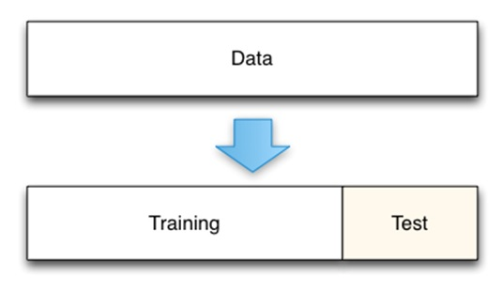
Model Development
Then the dataset was split into training(69081 ,80.0%) and testing (17271 ,20.0%)
Initial ARIMA parameters are identified based on ACF and PACF ARIMA(1,1,0)
Hyperparameter Tuning performed different p,d,q combinations
Final ARIMA(0,1,0) model selected based on lower RMSE
Predictions were generated on test data

Slide 9
Model Performance
Evaluated using MAE,RMSE and MAPE
MAE and RMSE may appear large but they are small when compared to overall bitcoin prices and low MAPE will indicates high prediction accuracy
Model Performance
MAE | 466.92
RMSE | 577.49
MAPE | 0.70

Slide 10
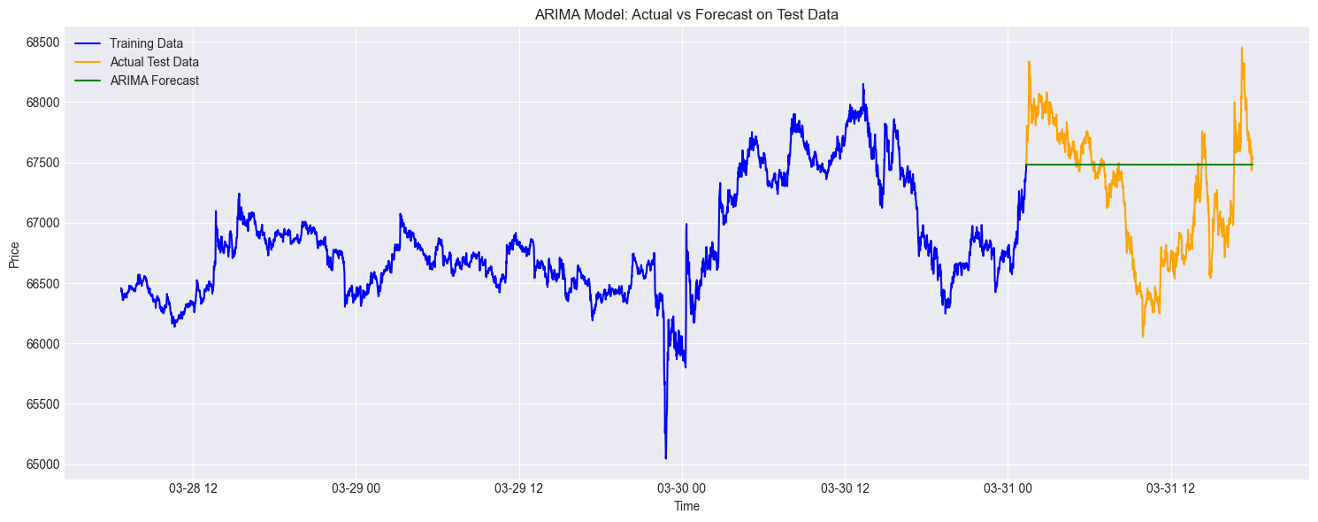
In the graph the blue line is training data which is bit coin price movement used to train the model
The orange-colored graph is test data which has some up and downs due to high market
The green represents the ARIMA predictions which is almost flat stable across test period
The graph between orange and green is actual and predicted ,The model is unable to capture sudden spikes and drops in price
The ARIMA model performs well in capturing the overall price level, but it does not accurately capture short-term fluctuations due to the high volatility of cryptocurrency markets

Slide 11
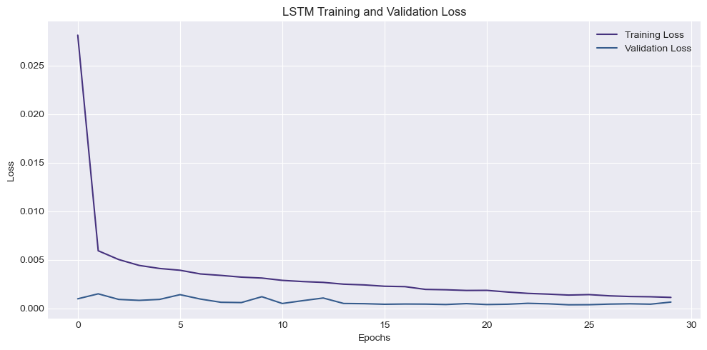
LSTM Model Training
Here I used 2 LSTM layers of 50 units each with dropout 0.2 which reduce overfitting
The model was trained on Adam optimizer and MSE loss function with 32 batch size , 50 epochs and 10% split validation
In the graph both training and validation loss decreases consistently, which shows the model is learning patterns effectively.
Also, both curves are closer to each other which indicating good generalization and no overfitting which shows the model is well trained for prediction

Slide 12
LSTM Model Performance
The LSTM is evaluated using MAE, RMSE, and MAPE
The values indicating predictions are very closer to actual values
Model Performance
MAE | 64.41
RMSE | 96.36
MAPE | 0.09%

Slide 13
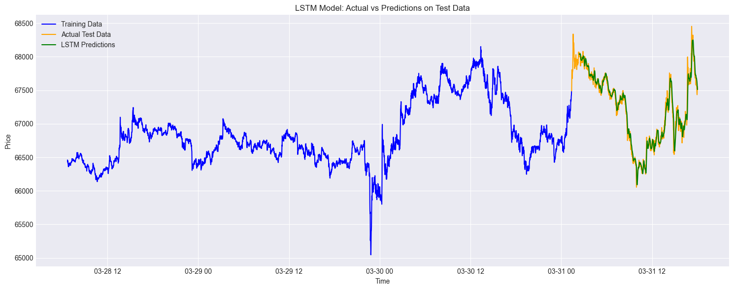
LSTM Actual vs Predicted graph
The above graph shows LSTM model predictions closely follows the actual bitcoin prices
The model is capturing well in both Trend and short-term fluctuations
This model is adapting to sudden changes

Slide 14
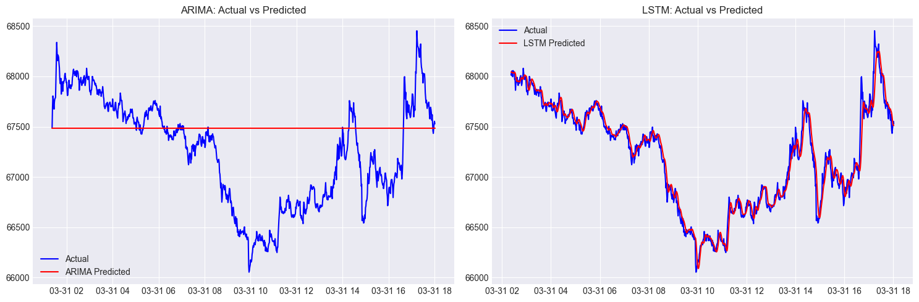
Model Performance (ARIMA vs LSTM)
Here in both models are useful in different perspectives
Arima produces both smooth and stable patterns and capturing overall trend in bitcoin prices but limited responses for short-term fluctuations.
On other-side LSTM is closely capturing both trend and fluctuations the model is adapting to sudden changes

Slide 15
Conclusion
In this project I have Implemented ARIMA and LSTM models
ARIMA performed well in capturing overall Trends
LSTM performed well in capturing both trends and fluctuations
The performance metrics showed LSTM have low error values
ARIMA provides a strong baseline for time series analysis
LSTM is more suitable for real-time cryptocurrency price forecasting since it has ability to handle complex and dynamic market behavior
.

Slide 16
Thankyou

